Slide 1
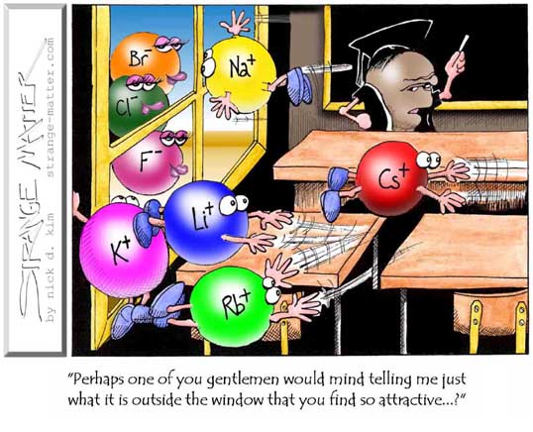
Bonding Introduction

Slide 2
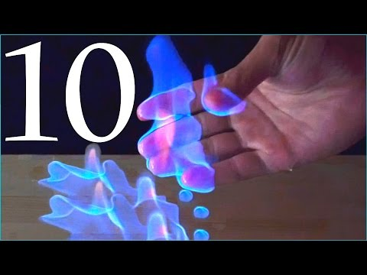
Bonding makes reactions possible!!

Slide 3
Bonding Questions to Ponder
Try to answer these questions…without your notes, the textbook or any other outside resource. Just use your head.
What is the difference between an ionic compound and a molecule?
What is the difference between a salt crystal, a sugar crystal and a piece of solid metal?
Are all bonds the same?
Why are the melting and boiling points of methane (CH₄) higher than the melting and boiling points of H₂?
Why doesn’t solid table salt conduct electricity?
Why does molten table salt conduct electricity?
Why is the melting point of table salt is so high? (+ 800 °C)
Can you explain why plastics quite strong, yet some are flexible and some are hard and rigid?
Is an air freshener a solid or a gas? Explain.
How can pencil lead and diamond be the same substance?

Slide 4
What is a Chemical Bond?
What is a chemical bond?
Are there different types? How do you know?
Why do bonds forms?

Slide 5
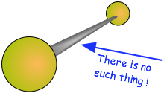
A Chemical Bond is not a physical structure.

Slide 6
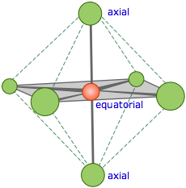
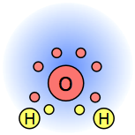
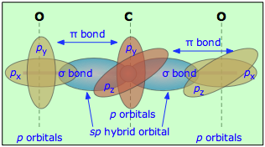
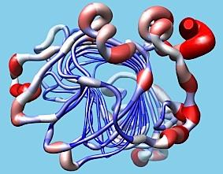
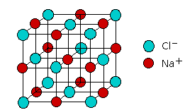

Slide 7
Chemical Bond:
The forces of attraction holding atoms or ions together

Slide 8
When do bonds form?
When the attractive forces between atoms are stronger than the repulsive interactions, atoms can bond
When one or more electrons are simultaneously attracted to two nuclei

Slide 9
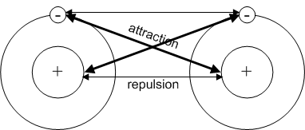
Attraction vs. Repulsion…the sweet spot

Slide 10
Why do bonds form?
The formation of a chemical bond is exothermic
Since the resulting structure has released energy, it is lower in energy and thus more stable

Slide 11
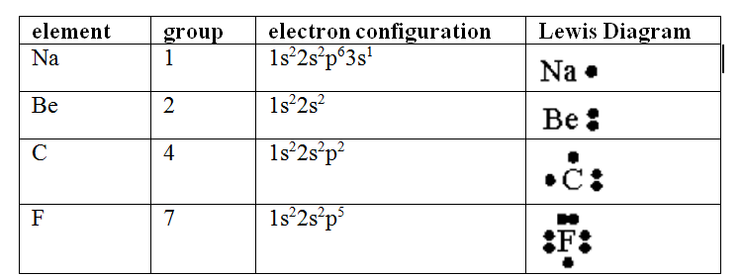
Lewis Symbol or Electron Dot Diagrams
Shows the chemical symbol and the electrons in the valence energy level ONLY
Useful in showing electron involvement in bond formation

Slide 12


Slide 13
Rules:
You only have 2 minutes to make as many compounds as you can
Once the timer goes work as fast as you can with the compounds on the slide
Once you have your compounds written down, you share your answers with the group
If you have a compound that no one else has, you get a point.
If other members have the compound too, no one gets points for that one.
The winner is the player after 2 rounds that gets the most points

Slide 14
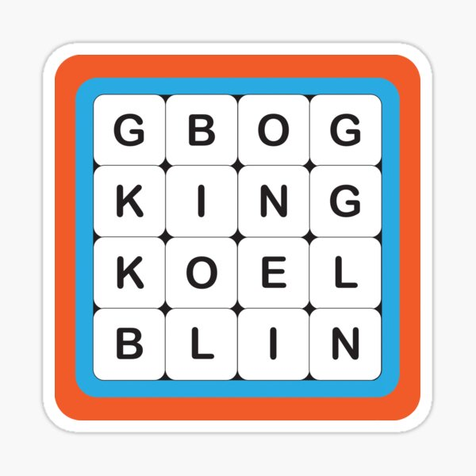
Boggle Board Number 1 (easier)
Na¹⁺
S²⁻
K¹⁺
Ba²⁺
Li¹⁺
Br¹⁻
P³⁻
N³⁻
Cr³⁺
O²⁻
Au³⁺
Sr²⁺
Fe²⁺
F¹⁻
I¹⁻
Cl¹⁻

Slide 15
Boggle Board Number 2 (harder)
Ag¹⁺
S²⁻
NH₄¹⁺
NO₃¹⁻
SO₄²⁻
Ca²⁺
Al³⁺
Ni³⁺
CO₃²⁻
OH¹⁻
Rb¹⁺
Zn²⁺
Sn⁴⁺
MnO₄¹⁻
CrO₄²⁻
CN¹⁻

Slide 16
Practice
Textbook
P. 73 #8, 10
Next up – Ionic vs covalent compound formation and properties

Slide 17
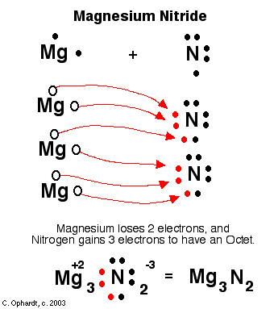
Identify as Ionic or Covalent on Whiteboards
1.

Slide 18
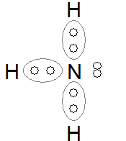
2.

Slide 19
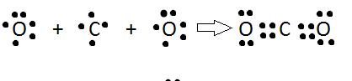
3.
What type of bond do the 4 dots between each atom pair represent? How to we show it in a structural formula?

Slide 20
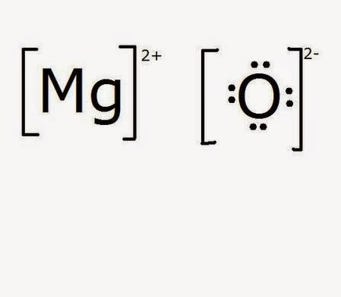
4.

